Slide 1




ATTENDANCE SYSTEM USING
FACE RECOGNITION

Slide 2

02
Made by ASL CODER
ASHWANI JHA(LEADER)
BRANCH: ITE
ENROLMENT NO. :03614813124
SHUBHAM JHA
BRANCH:CSE
ENROLMENT NO.:11514802724
LUCKY PRASAD
BRANCH:CSE
ENROLMENT NO.:16614802724

Slide 3
Problem Statement:
In educational institutions and workplaces, traditional attendance tracking methods, such as roll calls and sign-in sheets, are often time-consuming and prone to human error. These methods can lead to inaccuracies, lost paperwork, and increased administrative burden. Furthermore, manual attendance tracking can be challenging in large groups, resulting in missed records and inefficiencies.
The objective of this project is to address these challenges by implementing a facial recognition system for attendance tracking. This technology can streamline the process, ensuring accurate and efficient attendance recording while also reducing the workload for educators and administrators.

Slide 4
04
Key challenges:
INACCURACY IN MANUAL TRACKING: ERRORS IN RECORDING ATTENDANCE CAN AFFECT STUDENT GRADES AND EMPLOYEE ACCOUNTABILITY.
TIME CONSUMPTION: MANUAL METHODS TAKE SIGNIFICANT TIME, ESPECIALLY IN LARGE CLASSES OR TEAMS.
PRIVACY CONCERNS: IMPLEMENTING FACIAL RECOGNITION MUST CONSIDER DATA PRIVACY REGULATIONS AND ETHICAL CONCERNS.
TECHNOLOGICAL LIMITATIONS: THE EFFECTIVENESS OF FACIAL RECOGNITION CAN BE AFFECTED BY LIGHTING, ANGLES, AND FACIAL OBSTRUCTIONS.

Slide 5
Solution:
05
The proposed solution involves developing a facial recognition attendance system that automates the process of tracking attendance through advanced image processing techniques.
Components of the Solution:
Facial Recognition Software:
Utilize algorithms to detect and recognize faces from live video feeds or photos.
Implement deep learning models for improved accuracy and reliability.
User Database:
Create a database of registered users (students or employees) with their facial images.
Ensure that data is stored securely and complies with relevant privacy laws.

Slide 6
Integration with Existing Systems:
Connect the attendance system to existing school or company databases for seamless integration.
Provide real-time updates and reports on attendance.
User Interface:
Develop a simple and intuitive interface for both administrators and users.
Allow users to view their attendance records and for administrators to manage the system.
Privacy and Security Measures:
Implement data encryption and secure access protocols.
Ensure compliance with GDPR or similar regulations regarding personal data.

Slide 7
Benefits:
Efficiency: Reduces time spent on attendance tracking.
Accuracy: Minimizes human error and ensures precise attendance records.
Real-time Reporting: Allows for immediate access to attendance data.
Scalability: Can be scaled for use in larger institutions or organizations.
07

Slide 8
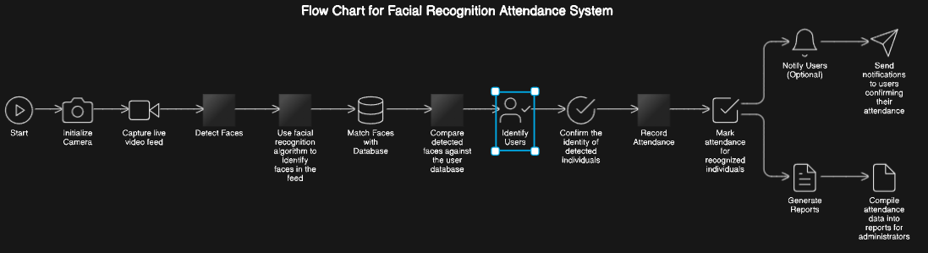
08
Flowchart:

Slide 9
Thank You

